Slide 1
NutriClick Application
Demo Description

Slide 2
Application Identity:
A smart personalized nutrition system provides timely nutritional advice to guide diet patterns.
Problem & Background:
Upward trend of overweight and obesity rates over the last two decades in Palestine, increasing by about 10% for both adult men and women, to reach levels above global and regional averages.
Both food secure and food insecure households are characterized with calorie-intensive diet with carbohydrates and fat being the main sources of calories indicating where empty calories are mainstays in Palestinian household diet.
Increase the risk of Non-communicable diseases (NCDs); the first cause of death among the Palestinians.

Slide 3
Solution & Value:
App tailored to the Middle East region users.
Offers easy-to-use nutritional facts of food (simple and complex)
provides a built-in logging tool for meals and exercise tracking.
Sets personalized goals, suggests meal plans, and supplies detailed statistics about nutrition (a complete breakdown of daily intake) with alerts and reminders to ensure that daily goals are met.
Provides alerts about food choices, which should be consumed or avoided, inappropriate portion sizes.
Advise on recipes and menu choices for food.

Slide 4
Data Management Plan:
Data Collection:
Data on food composition was collected from different research. A list of food items (simple and complex ) were compiled. Data on demographics, health indicators, consumption patterns, and physical activity levels will be collected from the users.
All datasets will be in a .csv file that can be exported into MS Excel, SAS, SPSS, or ASCII files.
Data specifications including; the size, file format, number of files, data dictionary, and codebook will be documented upon receipt of the data from the users. Any newly created variables during the data management and analysis process will be updated to the data specification.

Slide 5
Data Management Plan:
Documentation, Organization and Storage:
The data use log will document all data-related activities; Python “log” function will record and store all activities in relevant designated folders. The application developers will have access to secured cloud storage. Standard file naming convention will be used with a format: “Nutriclick_mmddyy_[initial of creator]”

Slide 6
Data Management Plan:
Archiving, Preservation and Curation:
A long-term data sharing and preservation plan will be used to store and make the data accessible. The data will be deposited into a cloud archive. Following the General Data Protection Regulation policies, the de-identified data will be accompanied by the appropriate documentation, metadata, and code to facilitate reuse and provide the potential for interoperability with similar data sets.

Slide 7
Data Management Plan:
Access, Sharing & Reuse:
Data sharing will require two steps of permission. 1) data use agreement from the users for pre-analysis data use, and 2) data use agreement from the developers for post-analysis data use.

Slide 8
Data Management Plan:
Metadata Storage
Will be created in compliance with the most relevant standard for the social, behavioral, economic, and health sciences—the Data Documentation Initiative (DDI). This standard facilitates preservation and enables flexibility in display.
Variable-Level Documentation: Application developers will tag variable-level information in DDI format for inclusion in the dataset, which allows users to identify relevant variables of interest. (App user level)
Technical Documentation: A summary DDI-based record will be created for inclusion in the searchable online catalog of the project’s website. This record will be indexed with terms from the health and nutrition glossary to enhance data discovery. (Web users level)

Slide 9
Data Management Plan:
Ethics and Privacy:
Informed consent: Informed consent statements will ask permission from users for their data to be used after being de-identified.
Disclosure risk management: Once deposited, the data will undergo procedures to protect the confidentiality of users whose personal information may be part of archived data. These include; (1) Rigorous review to assess disclosure risk. (2) Modifying data if necessary to protect confidentiality. (3) Limiting access to datasets in which the risk of disclosure remains high.
The data management for this project falls under HIPAA’s Privacy Rule to protect individuals’ medical records and other personal health information.

Slide 10
k-means clustering
Machine learning
k-modes clustering algorithm
cluster for current meal suggestion
cluster for nutrition sys suggestion
cluster for social network data and behavior
cluster for ignored cases (ex:alergies)

Slide 11
-DETECT ALL USERS THEY HAVE SAME CALORIES - FILTERING USERS DATA FIELD ,SOME WILL IGNORED FROM CLUSTER,SOME HAVE SIMILIRTY WITH AOTHERS - PUSH THE FINAL USER DATA IN k-MEAN CLUSTER -result: after filtering and clustering => suggest the current meal and the previous related one ,and after getting enough num from data row=>suggest nutrition sys
HOW ?

Slide 12
#read csv Food = pd.read_csv('food.csv') df=pd.DataFrame(Food).astype(str) print(df) #replace NAN with 0 df.fillna(0,inplace=True) df = pd.DataFrame(Food, columns=['age', 'city', 'activity', 'gender', 'mealtime', 'ITM1','ITEM2','ITEM3','ITEM4','ITEM5']) # Elbow curve to find optimal K cost = [] K = range(1,6) for num_clusters in list(K): kmode = KModes(n_clusters=num_clusters, init = "random", n_init = 5, verbose=1) kmode.fit_predict(data) cost.append(kmode.cost_) plt.plot(K, cost, 'bx-') plt.xlabel('No. of clusters') plt.ylabel('Cost') plt.title('Elbow Method For Optimal k') plt.show() # Building the model with 3 clusters kmode = KModes(n_clusters=5, init = "random", n_init = 5, verbose=1) clusters = kmode.fit_predict(data) clusters
MACHINE LEARNING

Slide 13
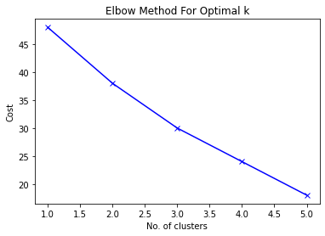
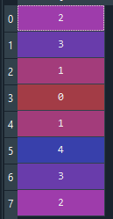
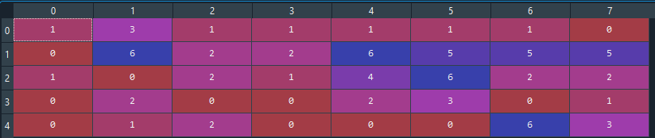

Slide 14
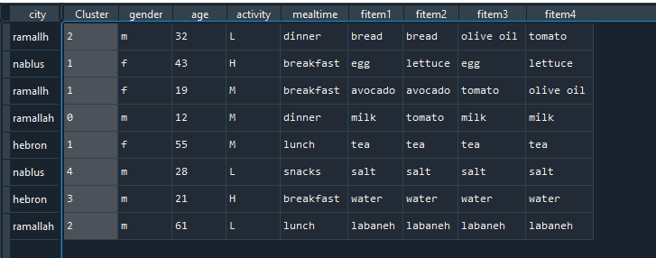

Slide 15
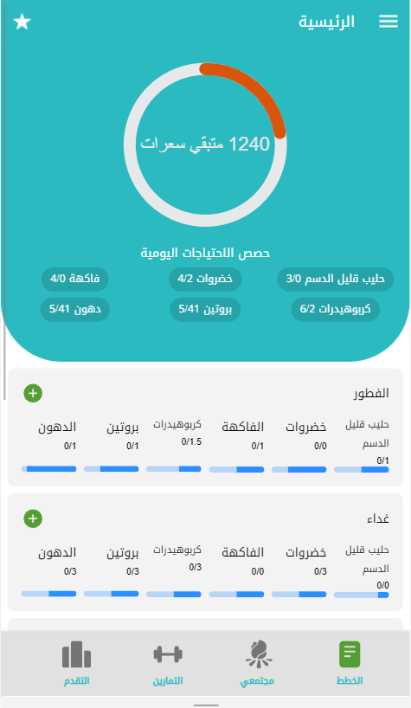
Technology used
Front end
Ionic Framework (angular)
Cross platform
Back end
Node js with express library
Database
MongnDB
Machine learning
Python language

Slide 16
User data
Calculate needs
Save to DB
Meal selection
System select
User select
machine learning
Process with k mode clustering
Bring the right food
Save meal to DB and bring to user
Select foods and save meal to DB
If accept meal
Save to DB

Slide 17
Application Features
اول تطبيق عربي مختص بالتغذية ومراقبة النشاط البدني
يشمل على اغلب المأكولات العربية الشرقية
يتوقع التطبيق رغبات المستخدم بالوجبات ويقوم باقتراح وجبة بناء على عوامل متشابه بينه وبين مستخدمين اخرين
يوفر التطبيق للمستخدم ميزة انشاء وجبة لوحده بناء على رغباته ويتم استخدام هذه الوجبات في جزئية تعلم الالة بالتطبيق
يوفر التطبيق لمستخدم ادخال الأنشطة البدنية التي قام بها
تم دمج فكرة السوشال ميديا بالتطبيق بحيث يوجد شاشة للمستخدمين للتفاعل فيما بينهم وتنزيل منشورات من نشاطهم اليومي الصحي
يوفر التطبيق شاشة تقارير التقدم للمستخدم ويمكنه مرجعة نشاطه في فترات متعددة
يتطلع التطبيق الى ادخال فكرة ربط التطبيق مع المتاجر المختصة بالمنتجات الصحية والمطاعم لتجهيز وجبات للمستخدم بناء على احتياجاته اليومية
يقوم التطبيق باظهار إعلانات للمستخدم بناء على توقعات النظام باحتياجات المستخدم

Slide 18
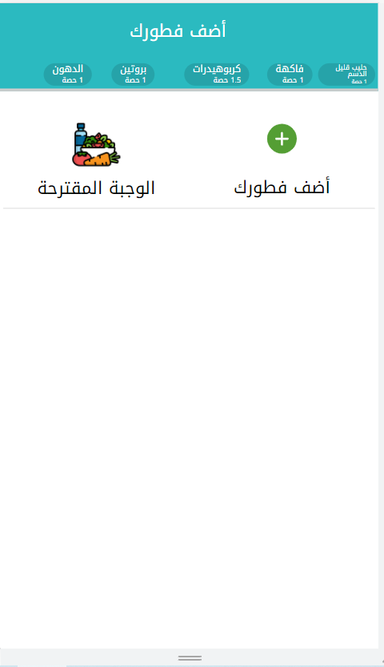
Machine learning process
1-الوجبة المقترحة
يقوم النظام باقتراح وجبة للمستخدم من وجبات سابقة لمستخدمين اخرين متشابهين مع المستخدم الحالي بعدة عوامل مثل عدد السعرات المتشابهة ومكان السكن والحساسية ووقت تناول الوجبة والعمر والجنس واكثر الأطعمة المستخدمة و يتم تطبيقها باستخدام
k mode clustering algorithm
2-يسمح التطبيق للمستخدم بأنشاء وجبة بنفسه ويتم عرض الأطعمة الملائمة له حسب احتياجاته ويختار المستخدم منها ويحدد الكمية ويتم استخدام هذه الوجبات في جزئية تدريب الالة في النظام

Slide 19
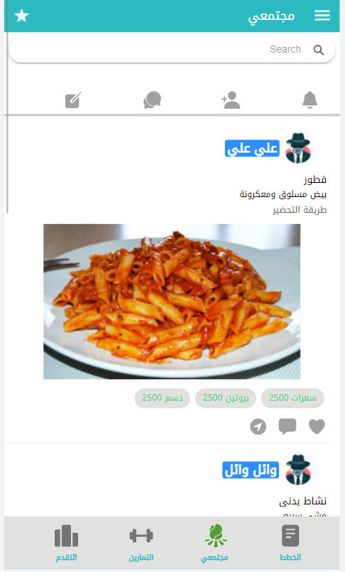
Use social media in app
It was used to increase user interaction with the application and encourage him to enter itThe user can publish posts according to his daily healthy activities
business plans in social media
1-Sponsored ads for restaurants and health products stores
2-Build multiple models on data collected from users and sell them like pharmaceutical companies

Slide 20
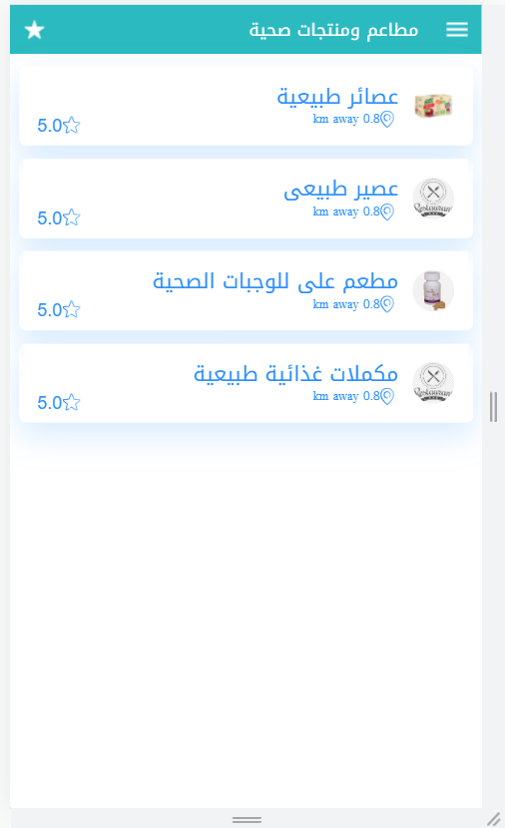
Connect the application with restaurants and health stores
1-Connect the application with restaurants to prepare meals for the user based on the daily needs of food ingredients
2-Connecting the application with health product stores necessary for the user

Slide 21
Challenges
Lack of a suitable dataset for nutrition programs
The dataset for Arabic food is manually built
The idea of the application has been changed several times to suit training requirements
New technologies used in application development(ionic, nodejs,,)
The application needs at least six months to be fully completed

